Slide 1


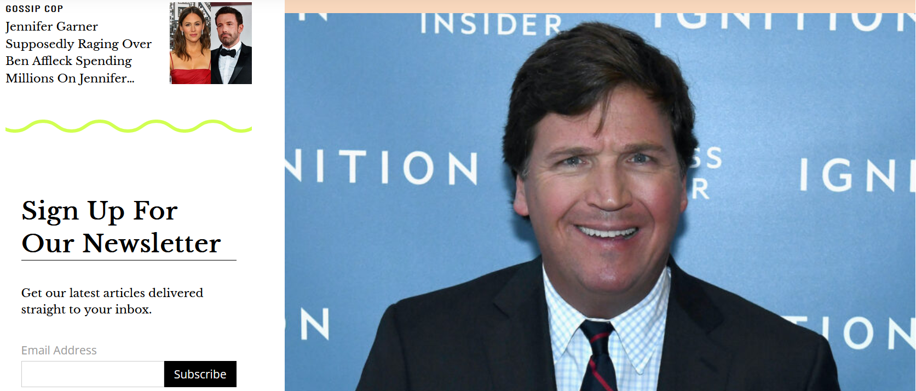
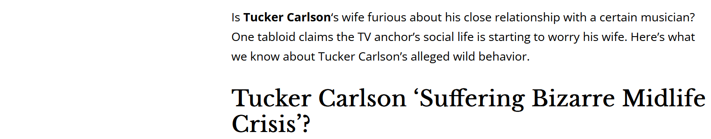
Suspicious news

Slide 2
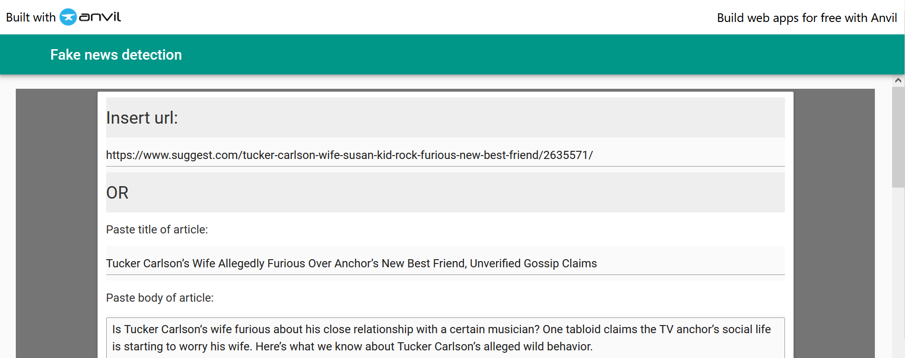
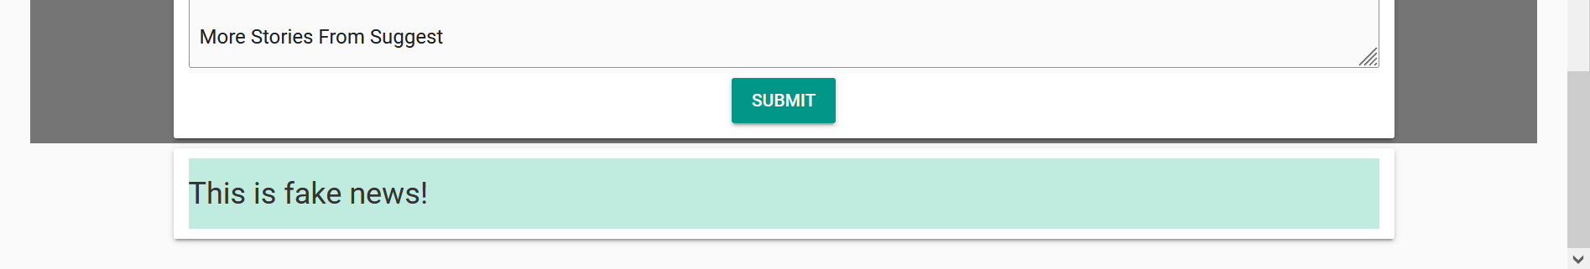
Copy the URL of the Article:
This is Fake news!

Slide 3
Analytics Lab
Fake news detection
April 27th, 2022
Coeinne, Oriane, Pablo, Juliette

Slide 4
Introduction

Slide 5


Background and Objectives
Social media has become a popular means for people to consume news. Meanwhile, it also enables the wide dissemination of fake news, which brings significant negative effects to the society.
Our objective is to develop a machine learning model to detect fake news on social media in order to prevent them from reaching broader audiences

Slide 6
Source & data pre-processing
Available Data
URL of the article
Fake news label
Title of the article
Tweet ids related to the article
(24,000 articles collected in 2018 from 2 sources - Politifact.com and Gossip Cop)
Web scraping
Extraction of news title and body
Gathering of news tweets data (i.e. dates and time of tweets publication, number of retweets, likes, replies and quotes)
+
Data cleaning & merging
Goal: combination of Natural Language Processing methods to process the title and content of the articles, and supervised learning algorithms to process the numerical values extracted from the tweets.

Slide 7
Data Analysis

Slide 8
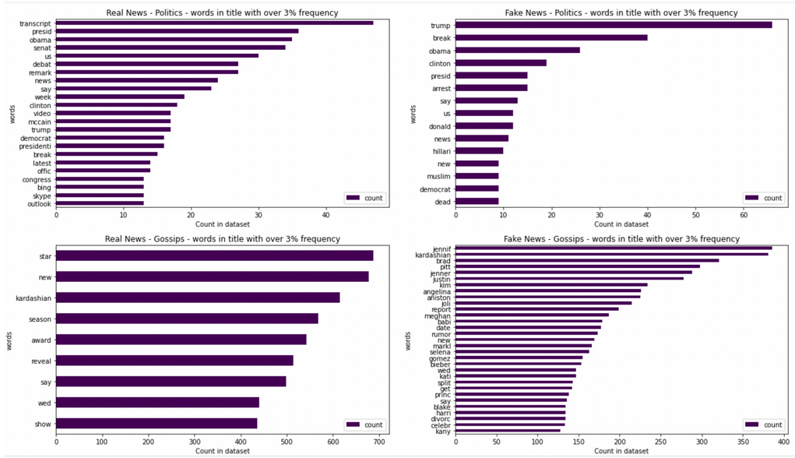
Word Occurrence in News Titles
Diversity of the frequent words changes according to the type of information and whether it is real or fake news
Fake news tend to include celebrities' names in their title more than that in Real news, in both Gosspics and Political news.

Slide 9
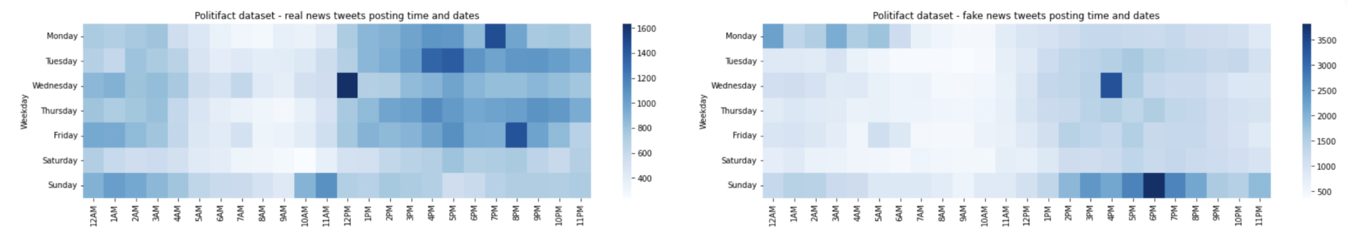
News Tweet Posting Day and Time
Politically related REAL news tweets
For fake news tweets, the posting concentrated on Sunday 2pm - 11pm and Monday 12am - 6am
This might due to some third parties systematically and purposefully using fake accounts to disseminate fake news to cause virality in the following week
Politically related FAKE news tweets

Slide 10
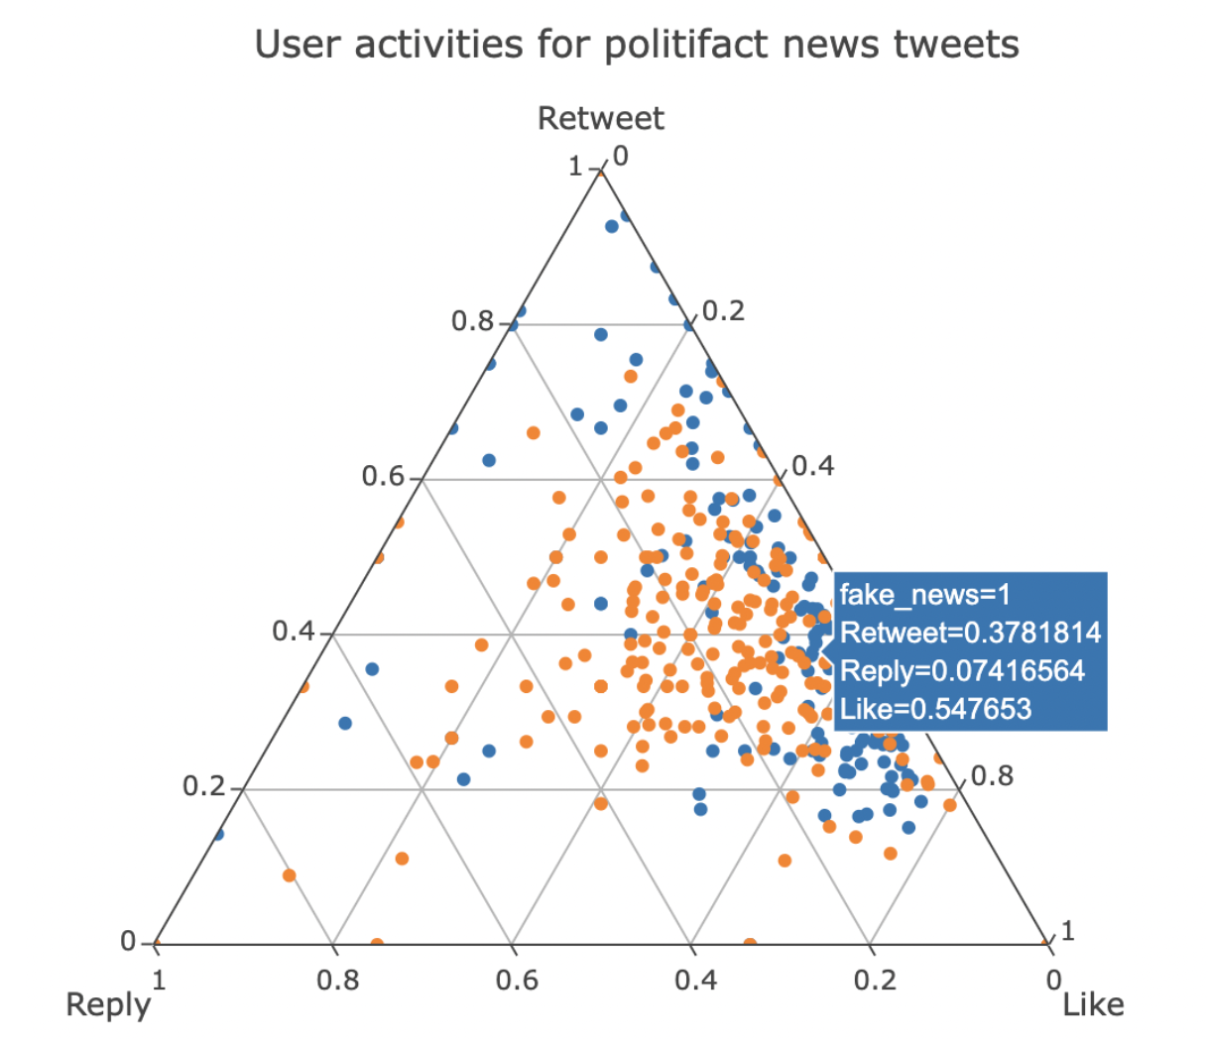
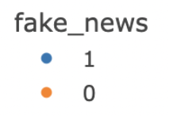
Twitter User Activities
More ‘Retweet’
Politically-related real news tweets (orange) received more replies than that of fake news tweets
Fake news tweets (blue) received more likes and retweets than replies
A study shows that the behaviors of likes and retweets are more emotional while replies are more rational, indicates that real news tweets received more rational user interaction, while fake news tweets has more emotionally user interaction
More ‘Like’ Less ‘Reply’

Slide 11
Models

Slide 12

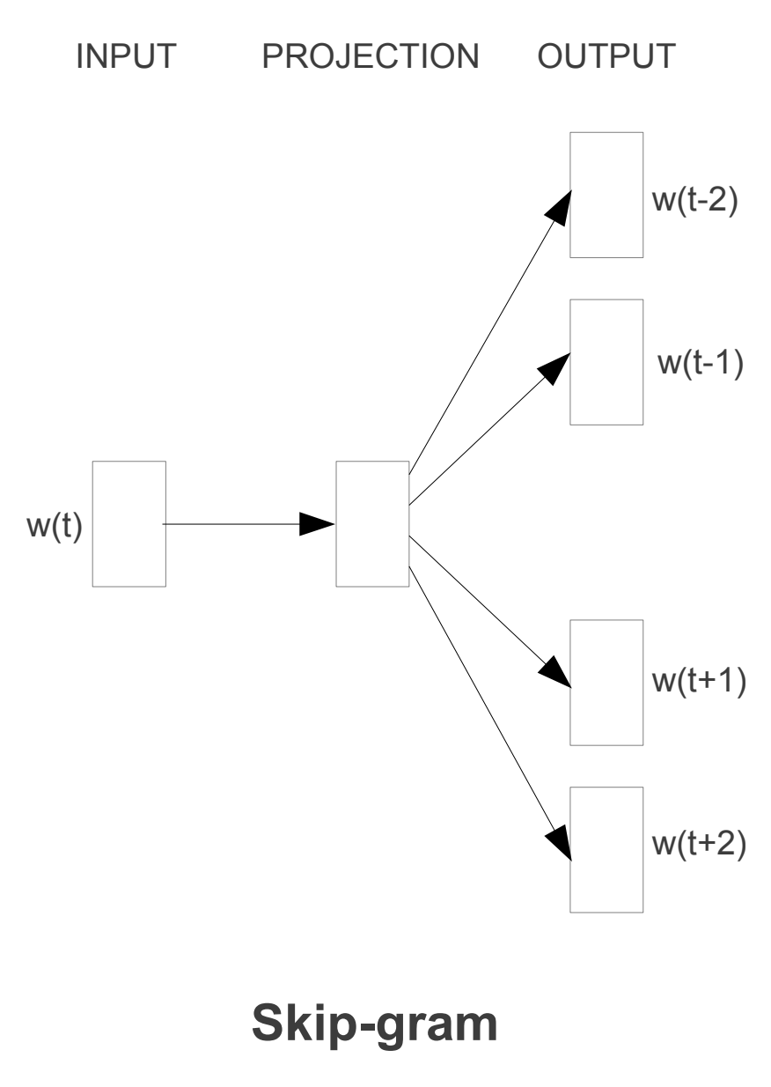
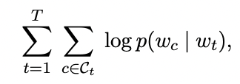
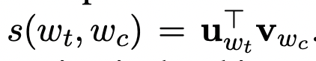
fastText
fastText is an open-source library developed by Facebook AI for learning of word embeddings and text classification
It is an extension of the skip-gram model
The function to maximize is the log likelihood:
The score between vectors (to maximize if they are in the same context) is:

Slide 13
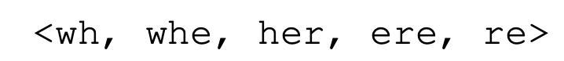
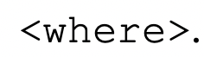
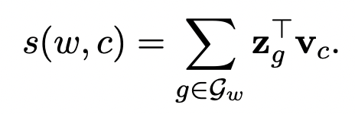
fastText
The difference with a traditional skip-gram model is that it takes into account internal words structure:
The scoring function becomes:
It gives us word vectors of dimension 300 after being trained on Wikipedia data.
For each article all the word embeddings are averaged and then a softmax function is used for the classification with the 300 features

Slide 14
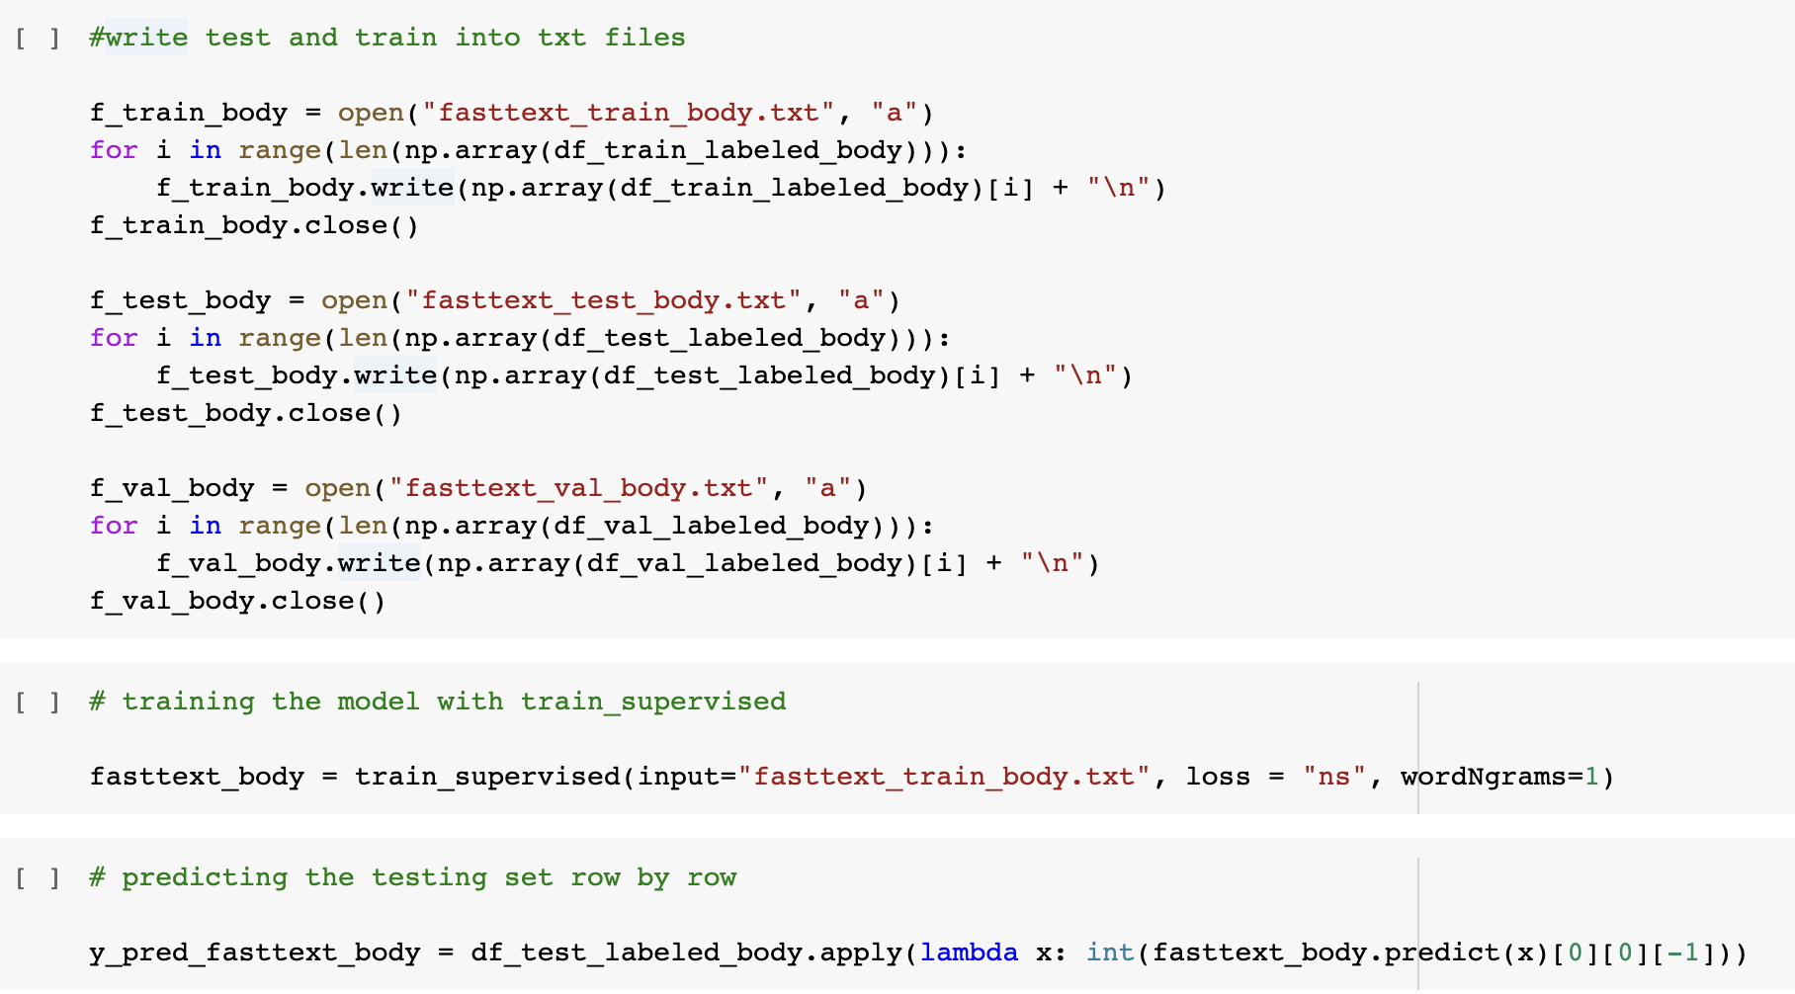
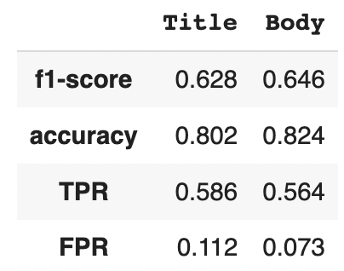
fastText
The model is performing very well:
And only takes a few seconds to run !

Slide 15
Word2vec + LogReg + XGBoost
Doc2Vec alike
News article
News title
Word2vec (Gensim)
Trained on FakeNewsNet titles
0.3
0.7
⋮
-0.1
0.4
-0.7
⋮
0.2
0.1
0.2
⋮
-0.5
Mean
0.2
0.1
⋮
-0.3
LogReg
Trained on titles
···
···
News body, News body,
News body.
Word2vec (Gensim)
Trained on FakeNewsNet bodies
0.1
-0.7
⋮
-0.2
0.1
0.3
⋮
0.4
0.1
-0.8
⋮
-0.9
Mean
-0.2
0.5
⋮
0.2
LogReg
Trained on bodies
···
···

Slide 16
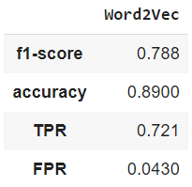
Word2vec + LogReg + XGBoost
0.3
0.7
⋮
-0.1
LogReg
Trained on titles
···
0.3
0.7
⋮
-0.1
LogReg
Trained on bodies
XGBoost
2000 trees
···
Real/Fake
Structured data
Great performance:
# Tweets
# Retweets
# Replies
# Likes
News source
With a long training time (2 word2vec models, XGBoost model…)

Slide 17
Impact & Conclusion

Slide 18
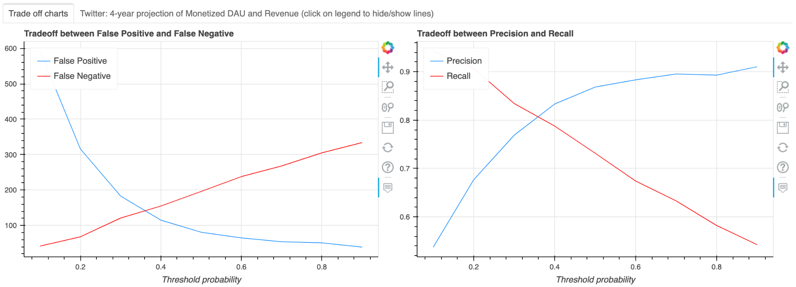
Trade Off Between Freedom of Speech and Control Fake News
Threshold probability ↑, less fake news will be flagged ( ↓ False Positive), more ‘Freedom of Speech’ and vice versa.

Slide 19
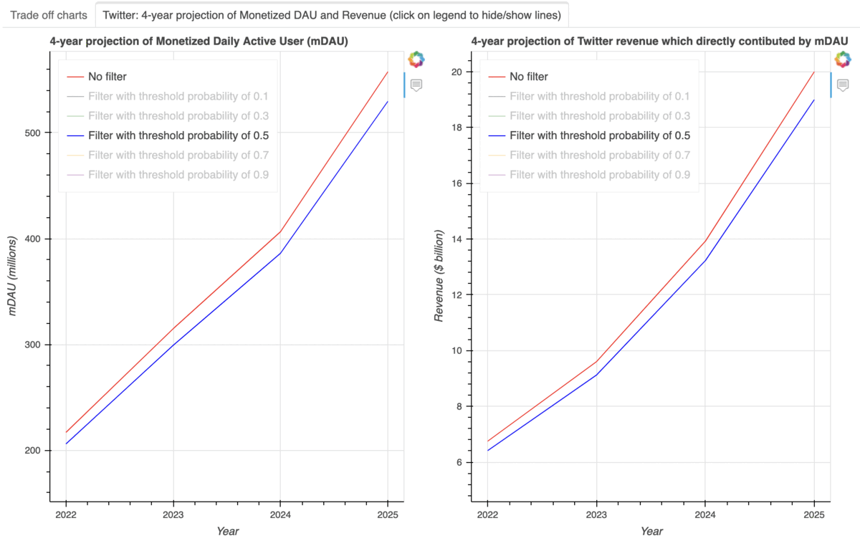
Business Consideration When Launching Fake News Filter

Slide 20
Conclusion
Recommended model for fake news detection on social media:
Not only news title and content, user behavior and activity on social media also provide useful information to identify fake news
When launching fake news filter, trade off between Freedom of Speech and control fake news will have impact on user experience on the platform
 | Model | Performance
Only news titles and body, without user activity on social media | fastText | F1-score (news title): 0.628 F1-score (news body): 0.646
Analyze news titles, contents, and user activity on Twitter | word2vec + LogReg + XGBoost | F1-score: 0.788 (↑22%-25%)

Slide 21
Appendix

Slide 22
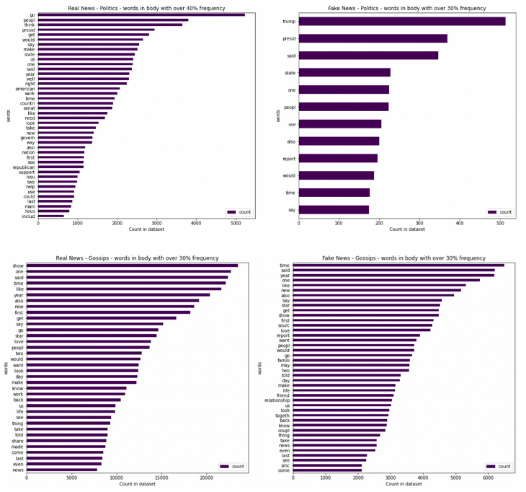
APPENDIX - Word Occurrence in News Body
For the Politics-related news, the words are more diversified in the Real news than in the Fake news and also seem less evasive words than in Fake news.
For Gossips-related news, it is difficult to compare the different words as they seem to be very close in meaning in both Fake and Real news.

Slide 23
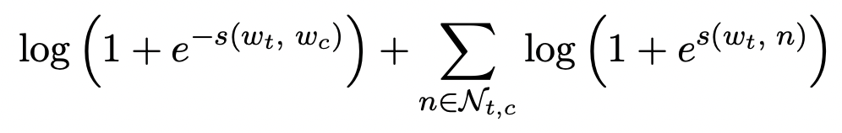
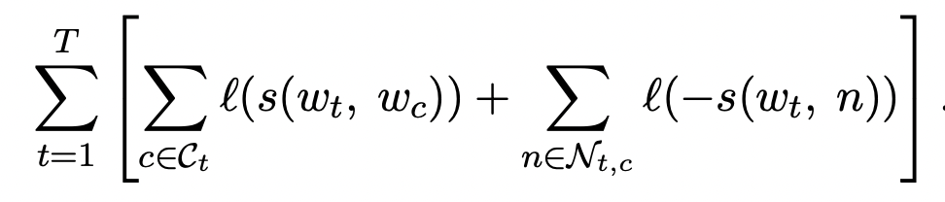
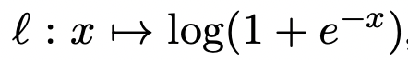
APPENDIX - Models - fastText
fastText is an open-source library developed by Facebook AI for learning of word embeddings and text classification
It is an extension of the skipgram model:
Loss function for 1 word:
Loss function for all words:
with

Slide 24
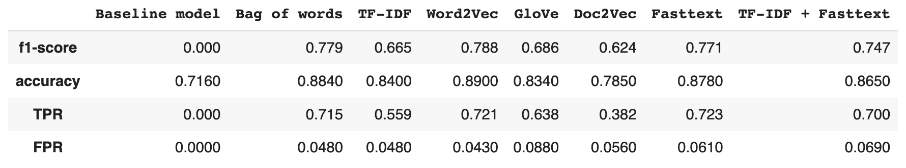
APPENDIX - All Model Performances

Slide 25
APPENDIX - mDAU and Revenue Assumption
Monetized Daily Active Users (mDAU): Twitter defines mDAU as people, organizations, or other accounts who logged in or were otherwise authenticated and accessed Twitter on any given day through twitter.com.
Annual revenue that directly contributed by mDAU: Twitter generates revenue from two major sources - advertising services and data licensing. 90% of the revenue is from the sale of advertising services, here we assume mDAU directly contributes to this revenue stream and loss of mDAU will impact this revenue stream proportionally.
Assumptions:
1. A study shows that people with higher educational level (college and above, which is 1/3 of Twitter's users) are less susceptible to fake news, so we assume this 1/3 of people care less about the impact from fake news filter as they are already able to identify fake news themselves. The other 2/3 will be sensitive to fake news filter and will be unhappy about frequent news flagging action, therefore we assume cost of falsely identify fake news (False Positive) will have 2 times impact of unable to identify fake news (False Negative).
2. Assume launching a fake news filter with threshold probability = 0.5 will cause 5% reduction in initial projection of annual mDAU
3. Assume 1% reduce in precision at threshold probability = 0.5 (increase in False Positive due to flag more news and less content available on Twitter) will result in 0.3% reduction in initial projection of mDAU
4. Assume 1% reduce in recall at threshold probability = 0.5 (increase in False Negative, unable to filter out majority of the fake news) will result in 0.15% reduction in initial projection of mDAU
5. Assume mDAU is directly responsible for 90% of Twitter revenue annually and each mDAU contributes equally to this 90% of revenue
6. Assume the Year-on-Year growth rate for both mDAU and revenue is the moving average of previous two years

